Slide 1
Network Boundaries
In-Process Conceptual Boundaries: just call Java code
Network (and Process) Boundaries: not so simple
Data must be serialized
Error codes must also be serialized

Slide 2
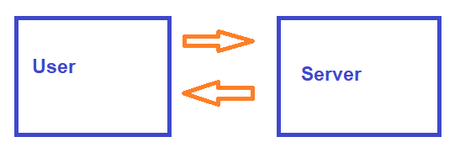
Communication
How do the orange arrows actually work?
Server: hostname (ip address) + port
User: sends data to that port, using the correct protocol

Slide 3
Multiple Java Processes
Same process = shared memory, use memory data (objects, etc) to communicate
Different processes = no shared memory
⇒ Most basic cross-process communication: File system
File System communication requires that the processes share a file system, this won’t work for multi-server setup

Slide 4
File System Communication
Two processes = (at least) two threads
Locks are objects
⇒ What to use instead?
Atomic File System operations
Note: There’s a reason this is unusual in practice

Slide 5
File System Communication - Not on Exam
Most common “lock”: file existence
May have seen with older programs
Also useful: rename() is atomic
Typical pattern:
Write contents to a temporary file
Rename the fully written file to some agreed upon cross-process name
Other process checks for existence of file, reads contents if it exists

Slide 6
Your Turn!
Clone the MultiProcessExercises repo from the link on Brightspace
Use the code from the exercise1 package
Fill out the ‘writeFileContents’ method in DataSender.java
Fill out the ‘readFileContents’ method in DataReceiver.java
Run both programs at once and see what happens
Put a breakpoint in DataSender in writeFileContents and DataReceiver in readFileContents, and walk through line by line; what actually triggers the breakpoint in DataReceiver?

Slide 7
Serialization Protocols
Many, many options. Some common ones:
XML - very verbose, allows for easy automated schema validation. Largely replaced by more compact formats
Example: Eclipse .classpath file
JSON - compact, human-readable
YAML - semantic whitespace, otherwise very similar to JSON
Example: Github Actions config files
Protocol buffers - multiple modes (very compact machine readable bits, compact human-readable format)
This is what we'll be using

Slide 8
Writing Java Code With Protocol Buffers
Write data definition in .proto file with proto2 syntax
Compile .proto file to Java code (.java files)
Use the classes from the auto-generated .java files in your code

Slide 9
Protocol Buffer Syntax
Full spec: https://protobuf.dev/reference/protobuf/proto2-spec/
Version note: we’ll be using proto2 (still the default); proto3 has some rough edges
Most common aspects:
int ⇒ int32
long ⇒ int64
String ⇒ string
boolean ⇒ bool

Slide 10
Protocol Buffer Syntax
class ⇒ message
enum ⇒ enum
List, [] array ⇒ repeated
Map ⇒ map

Slide 11
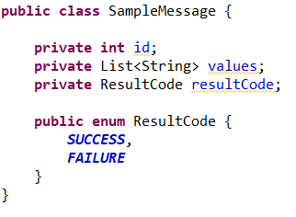
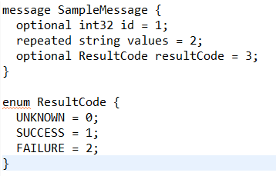
Protocol Buffer Syntax Example
Backwards-compatibility:
Declare all fields as optional or repeated, never required
Always have an 'unknown' option for enums

Slide 12
Compiling .proto -> .java
Equivalent of javac: protoc
Does not have the best usability
We already have a build configuration management tool that calls javac
⇒ Better solution: have gradle call protoc for you

Slide 13
Compiling .proto -> .java
Configure protobufs in build.gradle
add the plugin (this also configures grpc for later):
plugins {
id 'com.google.protobuf' version '0.9.4'
}
def grpcVersion = '1.59.1'
def protobufVersion = '3.25.1'
def protocVersion = protobufVersion
protobuf {
protoc { artifact = "com.google.protobuf:protoc:${protocVersion}" }
plugins {
grpc { artifact = "io.grpc:protoc-gen-grpc-java:${grpcVersion}" }
}
generateProtoTasks {
all()*.plugins { grpc {} }
}
}

Slide 14
Compiling .proto -> .java
Configure protobufs in build.gradle:
add the source sets - this uses a folder next to 'src' and 'test' called 'protobuf':
main {
proto {
srcDirs = ['protobuf']
}
java {
srcDirs = ['src',
'build/generated/source/proto/main/grpc',
'build/generated/source/proto/main/java']
}
}
Caution: Don't remove the test source sets!

Slide 15
Compiling .proto -> .java
Configure protobufs in build.gradle:
add the dependencies:
implementation "io.grpc:grpc-protobuf:${grpcVersion}"
implementation "io.grpc:grpc-services:${grpcVersion}"
implementation "io.grpc:grpc-stub:${grpcVersion}"
compileOnly "org.apache.tomcat:annotations-api:6.0.53"
runtimeOnly "io.grpc:grpc-netty-shaded:${grpcVersion}"
testImplementation "io.grpc:grpc-testing:${grpcVersion}"
testImplementation "io.grpc:grpc-inprocess:${grpcVersion}"

Slide 16
Compiling .proto -> .java
Refresh Eclipse metadata:
./gradlew eclipse
To recompile the protos (after any change to a .proto file), run:
./gradlew generateProto
and refresh Eclipse

Slide 17
Auto-Generated Code and Version Control
Best Practice: Don't commit compiled files, let the build configuration handle that
Ex: don't commit .class files, they'll just cause merge conflicts and Eclipse errors
For protos, don't commit the .java files, just the .proto files
⇒ Use your .gitignore to avoid committing the 'generated' directories

Slide 18
Auto-Generated Code and Version Control
How to get the .java files back so that github can compile the code?
Update the gradle.yml!
Add
./gradlew generateProto;
Before the
./gradlew build

Slide 19
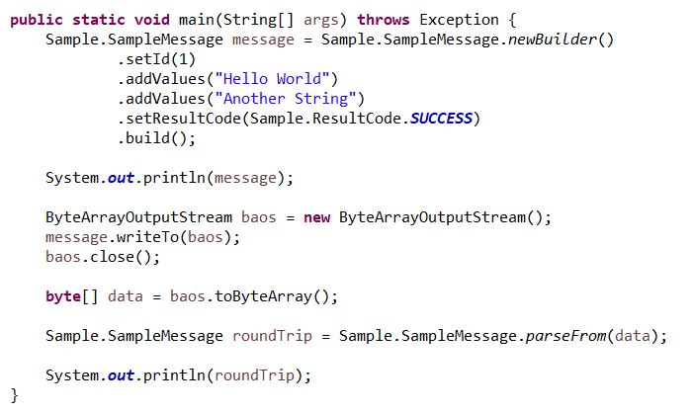
How to Use Compiled Protocol Buffers
Protoc generated classes:
create
read
write
Note the builder pattern!

Slide 20
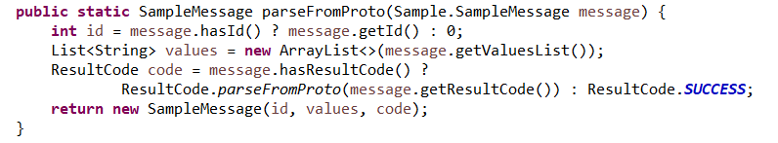
How to Use Compiled Protocol Buffers
Optional, often useful: Add a translation layer
The classes protoc generates are very data-layer-only; you can use them as-is, but often it's helpful to create an internal data representation
This is especially true for long-lived protos that have backwards compatibility cruft

Slide 21
Your Turn!
Use exercise2 from the MultProcessExercises repo
Create a .proto file that defines a Request and a Response message for the server (check out the TODOs for details)
Compile the .proto with ./gradlew generateProto
You'll need to declare a package for the output; use package <package name>; at the top of the .proto just as you would for a java file
Use the proto messages from (3) to fix the TODOs in Server
Use the proto messages from (3) to fix the TODOs in TestServer
Verify that the test passes

Slide 22
Writing Multiple Protos
Common Use Case:
For a single message, use writeTo
This includes messages wrapped in an outer message, ex:
message ProtoList {
repeated InnerProto = 1;
}
Unusual:
To write many messages, use writeDelimitedTo
Ex: Mix-and-match serialization of different types

Slide 23
Your Turn!
Re-use the code from exercise1
Change the FileWriter -> FileOutputStream and FileReader -> FileInputStream (Writer/Reader = characters, Input/OutputStream = bytes)
Fill out the ‘writeFileContents’ method in DataSender.java to write a protocol buffer message (can use any already-created ones)
Fill out the ‘readFileContents’ method in DataReceiver.java to read a protocol buffer message
Run both programs at once and see what happens

Slide 24
Protos as Persistence Format
Storing data in a database or other long-lived storage layer
Backwards Compatibility gets even more exciting:
What version was written?
Unless all data can be (and is) upgraded, arbitrarily long support window
Network compatibility is usually for just one version, this is harder
Advantages: compact, can be easily parsed into human-readable form
For long-term persistence, always include a version number

Slide 25
Backwards Compatibility
Old data, new code:
Ex: Old data is loaded out of a database by a new server
Ex: Un-upgraded client sends a request to an upgraded server
Missing newer fields ⇒ all new fields must have a sensible default behavior
Data in older fields ⇒ all deprecated fields must have an on-the-fly migration path (either ignored or upgraded)

Slide 26
Backwards Compatibility
New data, old code:
Ex: Upgraded server sends a response to an un-upgraded client
Missing older fields ⇒ all older (supported) fields must still be populated
Data in newer fields ⇒ all new data must be safe to ignore for older clients

Slide 27
Backwards Compatibility Best Practices
Never re-use a field number
Easy solution: when adding a new field, increment by one from the last field
This includes changing types/names; any changes are modeled as a 'delete and add' and count as re-using the field number
Always include a version number
This should be hardcoded in a .java file, ex: setVersion(VERSION)
The version should increment any time the persistence format changes

Slide 28
Your Turn!
Create a TextEditorPreferences message in a .proto file, with a string for preferred font and a bool for light vs dark mode.
Generate the .java files for this proto
Create a PreferenceStorer java class with a main method:
Create a TextEditorPreferences object
Store the object to a file as a proto message
Read the file back in, and populate a new object - print old vs new to the console to verify they're the same
Update the TextEditorPreferences message in the .proto file - add an int32 for preferred font size
Regenerate the .java files for this proto
Update PreferencesStorer to not write to the file (so you'll be reading the old, pre-step-4 format message)
Verify that you can still read the old format back into an object

Slide 29
Multiple Java Processes
Cross network is similar to cross process but instead of ‘writing to a file’, code is ‘writing to a port’
Same set of problems as files:
Notice when there is data
Get all the data, not just part of it
Parse the data into something useful

Slide 30
Network Communications
To send data to a server on a port, the client requests a connection and the server opens a socket
this alerts the server that data is incoming
allows data to pass back and forth from client ⇔ server
The socket is the rough equivalent of the shared file used previously

Slide 31
Multiple Java Processes
The low-level hardware side is a commonly solved problem, lots of libraries
We’ll be using gRpc (google remote procedure call)
gRpc, server-side:
Handles socket requests and creation (including authentication)
Reads all the data
Parses the bytes into a protocol buffer message
Sends the message to your code

Slide 32
Multiple Java Processes
The low-level hardware side is a commonly solved problem, lots of libraries
We’ll be using gRpc (google remote procedure call)
gRpc, client-side:
Handles socket requests and creation (including authentication)
Turns a protocol buffer message into bytes
Sends the bytes to server
Gets a response back as bytes
Parses those bytes into a protocol buffer message
Returns the message to your code

Slide 33
Endpoint Definitions
Allows one port to respond to many different requests
Typically implemented via a REST API
Common (not universal) practice: server calls are stateless, meaning the client must manage all state between calls
allows for easy handling of multiple clients at once and graceful client disconnects
Different methods on the server correspond to different paths (often part of a URL)
ex: https://graph.facebook.com/facebook/picture?redirect=false

Slide 34
gRPC & Protobuf: Peanut Butter & Jelly
Interoperable configuration language to specify
Endpoints (gRpc)
Serialization format (protobuf)
Compiles to many languages, including (but not limited to):
Java
C++
Python
Typescript (which compiles to Javascript)

Slide 35
Using gRPC
Pieces of the server:
Endpoint definitions - .proto file
Message definitions - .proto file
Server definition - .java file
Client definition - .java file (or other language!)

Slide 36
Endpoint Definition - Just an API!
In the same way that classes translate to proto messages, APIs (interfaces) translate to a gRPC service.
public interface PhoneOrderService {
public PhoneOrderResponse createPhoneOrder(PhoneOrderRequest request);
}
service PhoneOrderService {
rpc CreatePhoneOrder (PhoneOrderRequest) returns (PhoneOrderResponse) {}
}

Slide 37
Endpoint Definition - Just an API!
In the same way that classes translate to proto messages, APIs (interfaces) translate to a gRPC service.
public interface PhoneOrderService {
public PhoneOrderResponse createPhoneOrder(PhoneOrderRequest request);
}
service PhoneOrderService {
rpc CreatePhoneOrder (PhoneOrderRequest) returns (PhoneOrderResponse) {}
}

Slide 38
Endpoint Definition - Just an API!
In the same way that classes translate to proto messages, APIs (interfaces) translate to a gRPC service.
public interface PhoneOrderService {
public PhoneOrderResponse createPhoneOrder(PhoneOrderRequest request);
}
service PhoneOrderService {
rpc CreatePhoneOrder (PhoneOrderRequest) returns (PhoneOrderResponse) {}
}

Slide 39
Endpoint Definition - Just an API!
In the same way that classes translate to proto messages, APIs (interfaces) translate to a gRPC service.
public interface PhoneOrderService {
public PhoneOrderResponse createPhoneOrder(PhoneOrderRequest request);
}
service PhoneOrderService {
rpc CreatePhoneOrder (PhoneOrderRequest) returns (PhoneOrderResponse) {}
}

Slide 40
What Does This Create?
To the IDE!
Run ./gradlew generateProto
Manually refresh the project in the IDE

Slide 41
Client/Server Definition - Boilerplate
Server/Client code can be treated as a template - included on Brightspace
"Interesting" code lives in the actual client method call (order() in the example), and the <serviceName>ServiceImpl on the server

Slide 42
Server Definition
Create the actual implementation for the API methods:
Create a class that extends the <serviceName>ImplBase
Override each rpc method with an actual implementation
Use onNext/onCompleted to return a value
Caution: Don't use onError - that's for something going wrong at the networking layer

Slide 43
Server Definition
Start up the server on a particular port:
For simple cases, no login is required, so don't require credentials
Pick a unique-ish port (for an actual production server, this would be specified in a config file, not the actual binary)

Slide 44
Client Definition
gRPC does not require a specific client language - you can use any client you want!
Some useful examples:
Command line - grpc and curl often don't play well, use grpcurl instead (https://github.com/fullstorydev/grpcurl)
Ex: grpcurl -plaintext -d "{\"model\": \"android\"}" localhost:50051 phoneorder.PhoneOrderService/CreatePhoneOrder
Returns
{
"orderNumber": "not implemented yet"
}

Slide 45
Client Definition
Java Client: Similar to server, use a template
Once you have a <servicename>Client variable:
call methods on it as defined in the .proto file
Usually, create request messages, check response messages
Can prompt the user for input with a Scanner/report information with println

Slide 46
Your Turn!
Create an AddingMachine server, and query it with either a java client or curl:
Create a .proto file with
an AddingRequest that includes two integers
an AddingResponse that includes an integer result and an error code (remember the optional keyword!)
an AddingMachine service with an add rpc that takes an AddingRequest and returns an AddingResponse
Generate all the proto and gRPC files
Create an AddingMachineServer.java that starts up an AddingMachine service
Create a client, or use grpcurl, to verify that your server can correctly add 2 + 3

Slide 47
Let's Review, Serialization & Protobuf
3 major serialization formats
How to specify int, long, String, and boolean in a .proto file
How to handle backwards compatibility with protocol buffer: adding new fields, removing old fields, including a version number
How to specify a message in a .proto file

Slide 48
Let’s Review, gRPC
How to specify a service in a .proto file
What happens when sending a message from client to server with gRPC (open a socket, serialize/deserialize data, connect to your code)
How to return a value from the .java implementation of a gRPC service
An advantage of multi-process computing over multi-threaded-but-single-process computing
Ways to design for multi-process computing

